Slide 1
Clustering
Lee-Ad Gottlieb

Slide 2
Clustering
Supervised learning: sample points have labels
Unsupervised learning: no labels!
Still possible to learn
For example, cluster these points into two groups

Slide 3
k-clustering
Goals for clustering:
Learning: A new point can be assigned a group
Compression: May only need to retain K, not S
Better generalization bounds
Run-time: nearest neighbor search on base set K, not S
new point

Slide 4
k-clustering
Generalization bounds via compression.
What’s the VC-dimension of learning (classification) via k-clustering?
Choose a center set K of size k from S: ~|S|^{k} possibilities.
If d points are shattered,
d^{k} ≥ 2^{d}
k log d ≥ d
d = O(k log k)

Slide 5
Clustering algorithms
Problem: Given a sample S of n points and a parameter k
cluster S into k groups.
Question of measure: What’s a good clustering?
Different measures: k-center, k-median, k-means
S

Slide 6
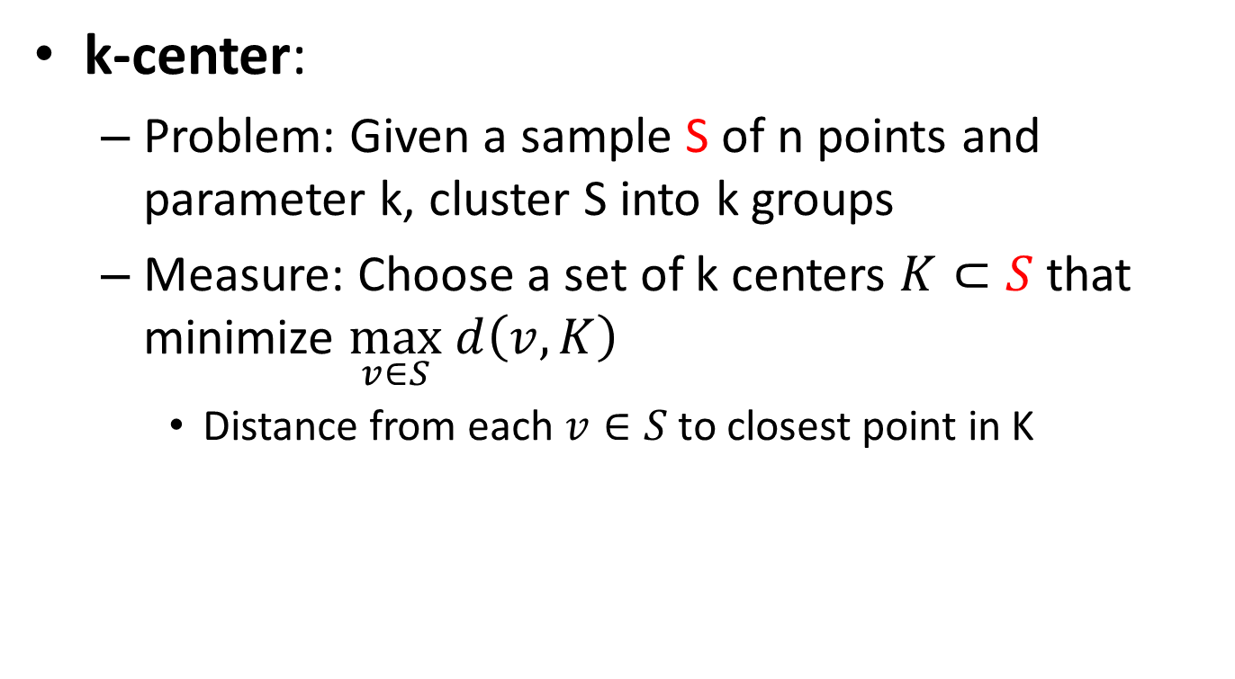
k-center clustering
k-center:
Problem: Given a sample S of n points and parameter k, cluster S into k groups
Measure: Choose a set of k centers $K⊂S$that minimize $\max_{v∈S} d\left(v,K\right)$
Distance from each $v∈S$ to closest point in K
S
K

Slide 7
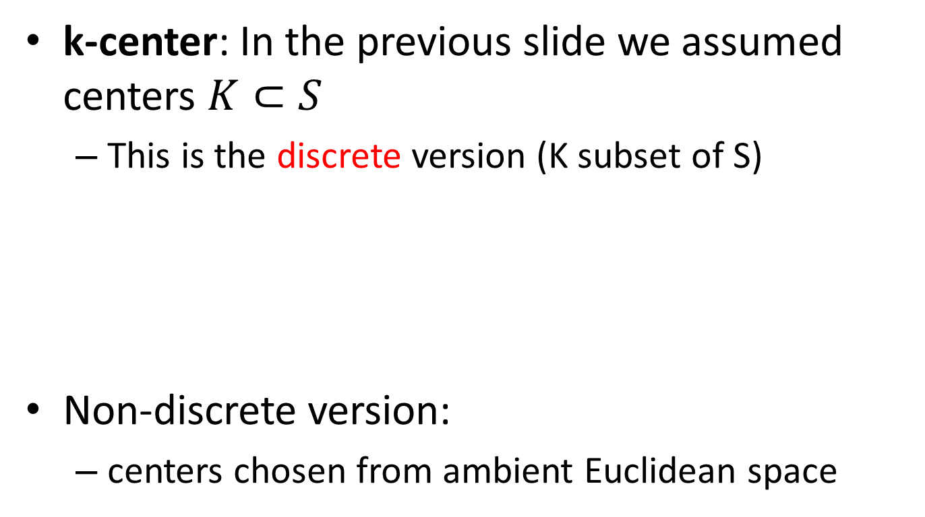
k-center clustering
k-center: In the previous slide we assumed centers $K⊂S$
This is the discrete version (K subset of S)
Non-discrete version:
centers chosen from ambient Euclidean space

Slide 8
k-center clustering
Exact algorithm for discrete k-center:
Brute force: try all sets of k points in S
in O(|S|^{k}) time
Can we do better?
S

Slide 9
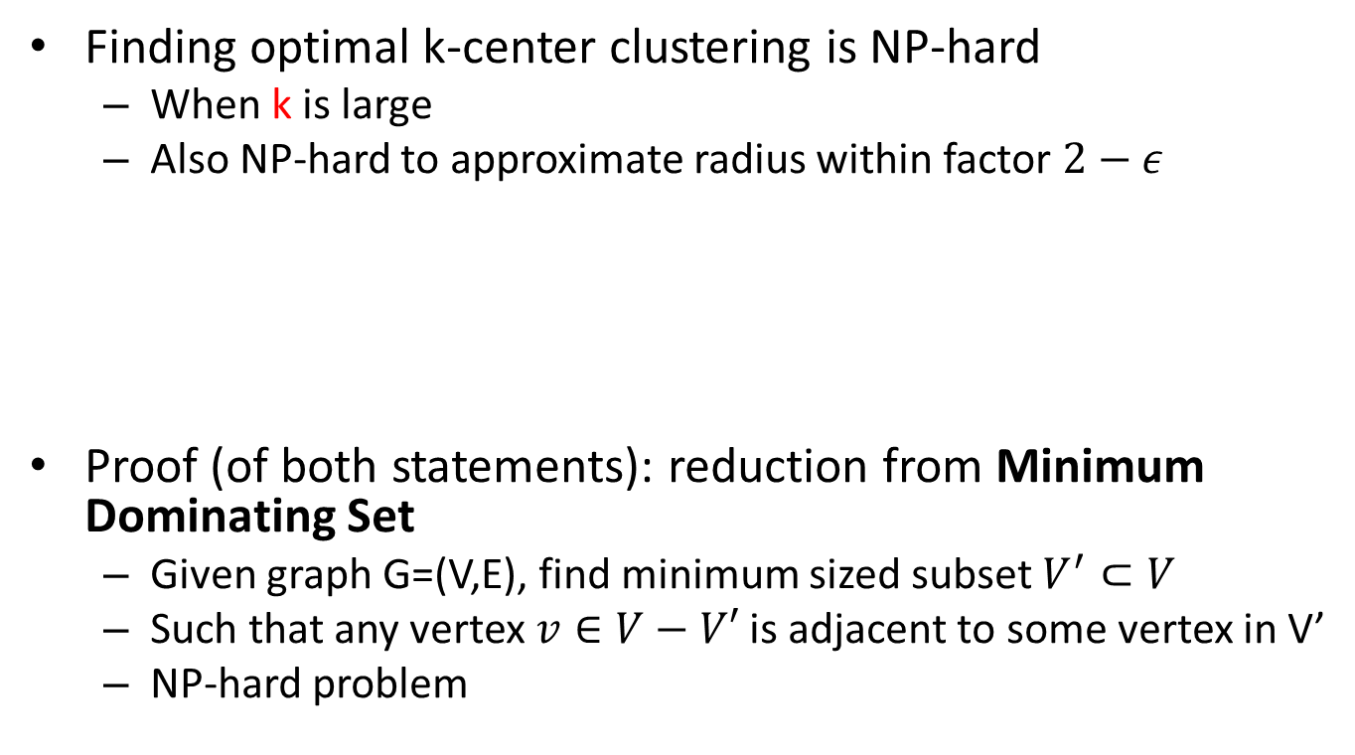
k-center clustering
Finding optimal k-center clustering is NP-hard
When k is large
Also NP-hard to approximate radius within factor $2−ε$
Proof (of both statements): reduction from Minimum Dominating Set
Given graph G=(V,E), find minimum sized subset $V^{′}⊂V$
Such that any vertex $v∈V−V′$ is adjacent to some vertex in V’
NP-hard problem
1
Graph for
Dominating
Set problem
Point set
For k-center
clustering
1
1
1
1

Slide 10
k-center approximation
K-center is NP-hard to solve exactly
Two possible polynomial-time approximation algorithms for the discrete case:
1. Optimal radius, but k(ln n) centers
NP-hard to get less than k(ln n) centers
2. k centers, but larger radius
NP-hard to do better than twice the radius

Slide 11
k-center approximation
First approximation algorithm:
Optimal radius, but (k ln n) centers
Greedy algorithm:
Assume optimal radius r is known (n² guesses)
Take center which covers most points
Remove covers points and repeat

Slide 12
k-center approximation
First approximation algorithm:
Optimal radius, but (k ln n) centers
Greedy algorithm:
Assume optimal radius r is known (n² guesses)
Take center which covers most points
Remove covers points and repeat

Slide 13
k-center approximation
First approximation algorithm:
Optimal radius, but (k ln n) centers
Greedy algorithm:
Assume optimal radius r is known (n² guesses)
Take center which covers most points
Remove covers points and repeat

Slide 14
k-center approximation
Greedy not necessarily optimal
Greedy:
A
B
C
D

Slide 15
k-center approximation
Greedy not necessarily optimal
Optimal:

Slide 16
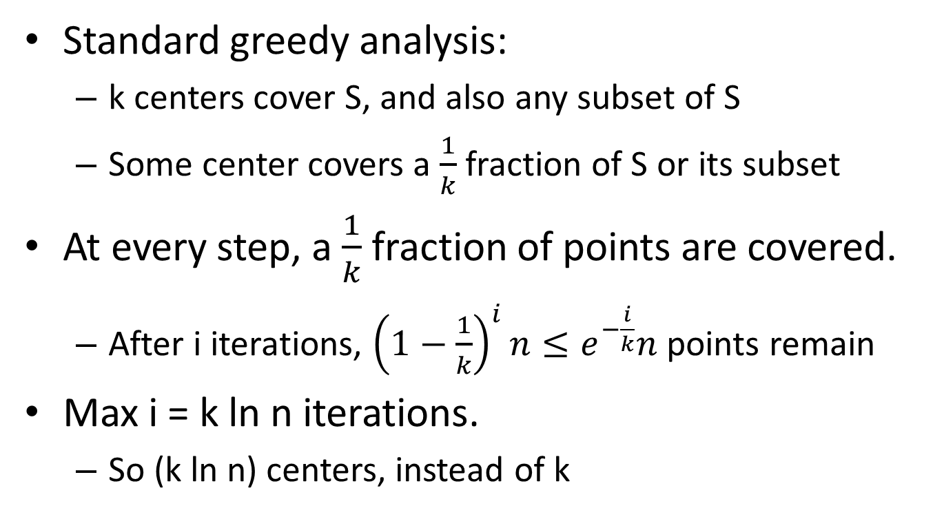
k-center approximation
Standard greedy analysis:
k centers cover S, and also any subset of S
Some center covers a $\frac{1}{k}$ fraction of S or its subset
At every step, a $\frac{1}{k}$ fraction of points are covered.
After i iterations, ${\left(1−\frac{1}{k}\right)}^{i}n≤e^{−\frac{i}{k}}n$ points remain
Max i = k ln n iterations.
So (k ln n) centers, instead of k

Slide 17
k-center approximation
Second approximation algorithms:
k centers, but larger radius
Greedy algorithm:
Choose the farthest uncovered point

Slide 18
k-center approximation
Second approximation algorithms:
k centers, but larger radius
Greedy algorithm:
Choose the farthest uncovered point
Example: k=4
1

Slide 19
k-center approximation
Second approximation algorithms:
k centers, but larger radius
Greedy algorithm:
Choose the farthest uncovered point
Example: k=4
2
1

Slide 20
k-center approximation
Second approximation algorithms:
k centers, but larger radius
Greedy algorithm:
Choose the farthest uncovered point
Example: k=4
2
1
3

Slide 21
k-center approximation
Second approximation algorithms:
k centers, but larger radius
Greedy algorithm:
Choose the farthest uncovered point
Example: k=4
2
1
3
4

Slide 22
k-center approximation
Second approximation algorithms:
k centers, but larger radius
Greedy algorithm:
Choose the farthest uncovered point
Example: k=4
Now choose min radius
2
1
3
4

Slide 23
k-center approximation
Greedy algorithm:
Choose the farthest uncovered point
Claim: Final radius r at most 2r*
Where r* is optimal radius
At least k+1 balls of radius less than r/2 needed to cover all points.
So r/2 ≤ r* ≤ r
2
2
1
3
1
3
4
4

Slide 24
k-center approximation
What about the non-discrete case?
(Centers come from ambient space, not S)
Can just solve the discrete case
Lose a factor 2 in the radius.

Slide 25
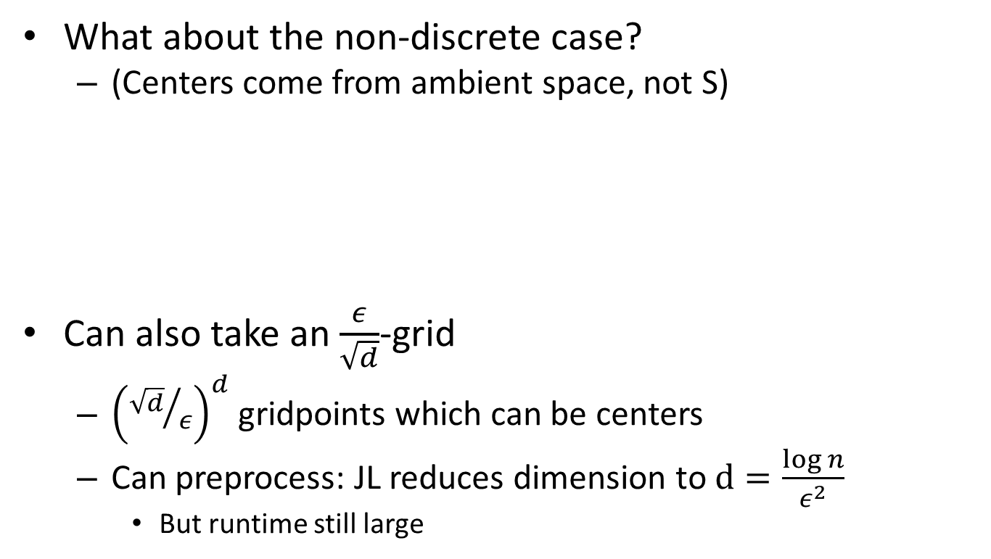
k-center approximation
What about the non-discrete case?
(Centers come from ambient space, not S)
Can also take an $\frac{ε}{\sqrt{d}}$-grid
${\left({\sqrt{d}}/ε\right)}^{d}$ gridpoints which can be centers
Can preprocess: JL reduces dimension to $d=\frac{\log{n}}{ε^{2}}$
But runtime still large

Slide 26
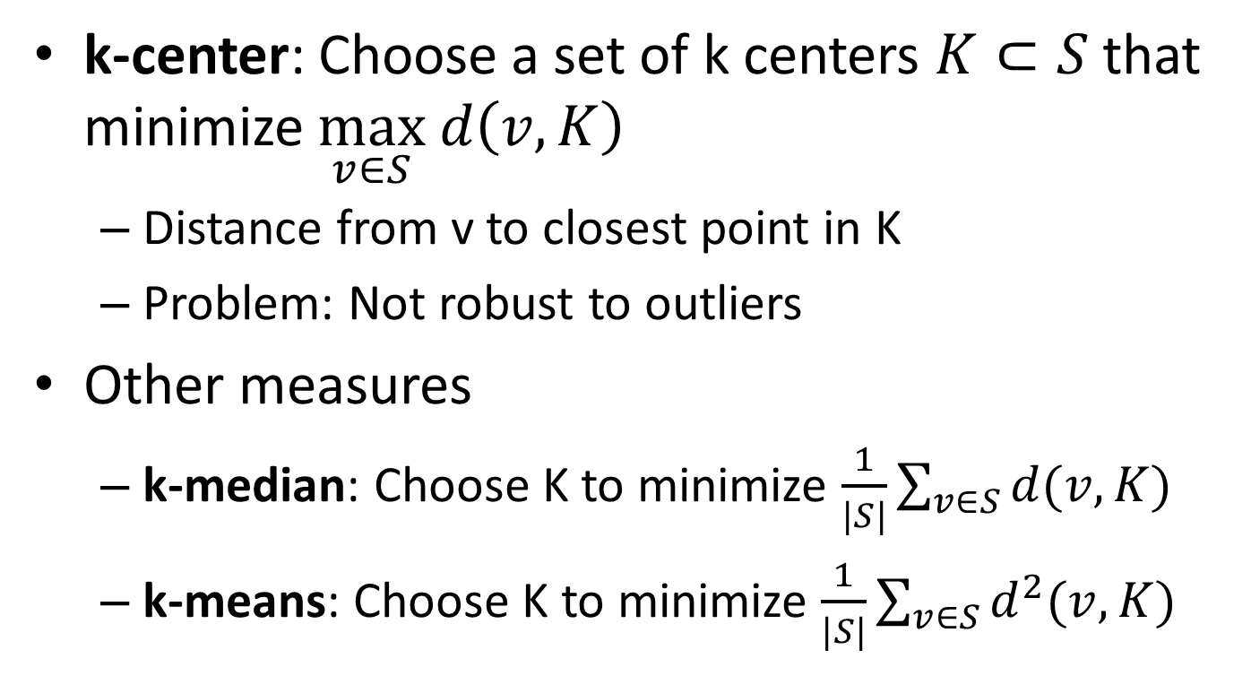
Clustering
k-center: Choose a set of k centers $K⊂S$that minimize $\max_{v∈S} d\left(v,K\right)$
Distance from v to closest point in K
Problem: Not robust to outliers
Other measures
k-median: Choose K to minimize $\frac{1}{|S|}\sum_{v∈S}{d(v,K)}$
k-means: Choose K to minimize $\frac{1}{|S|}\sum_{v∈S}{d^{2}(v,K)}$

Slide 27
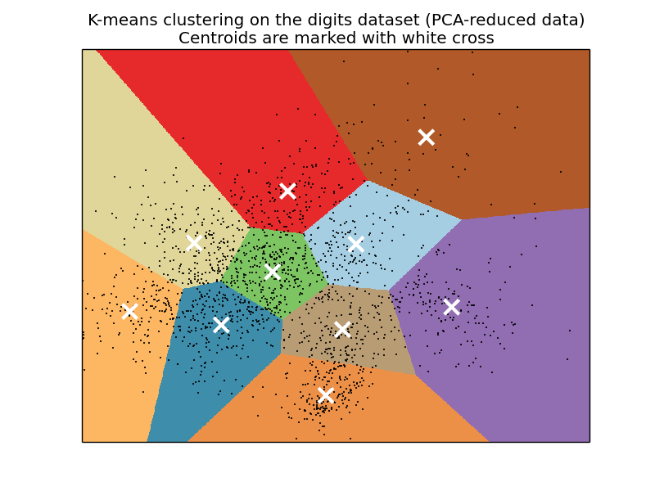
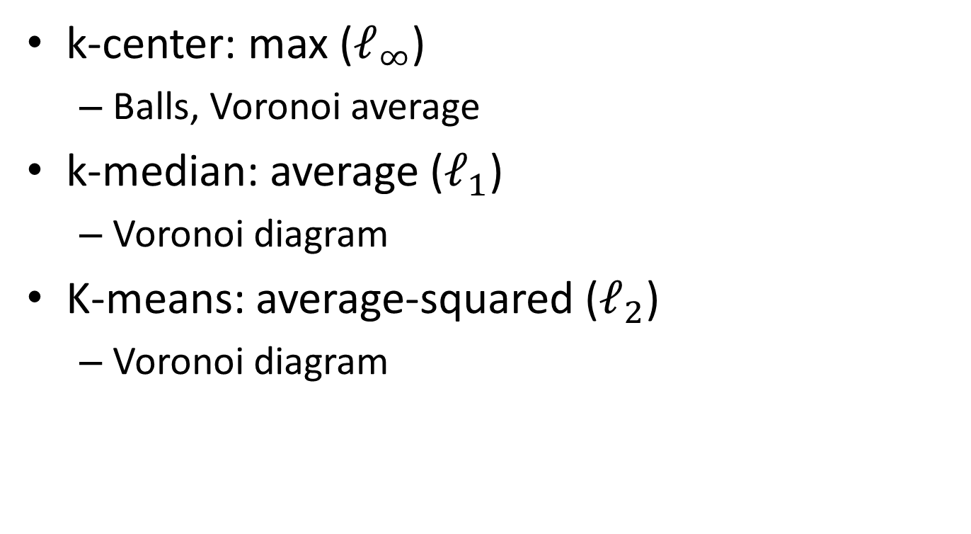
Clustering
k-center: max ($ℓ_{∞}$)
Balls, Voronoi average
k-median: average ($ℓ_{1}$)
Voronoi diagram
K-means: average-squared ($ℓ_{2}$)
Voronoi diagram

Slide 28
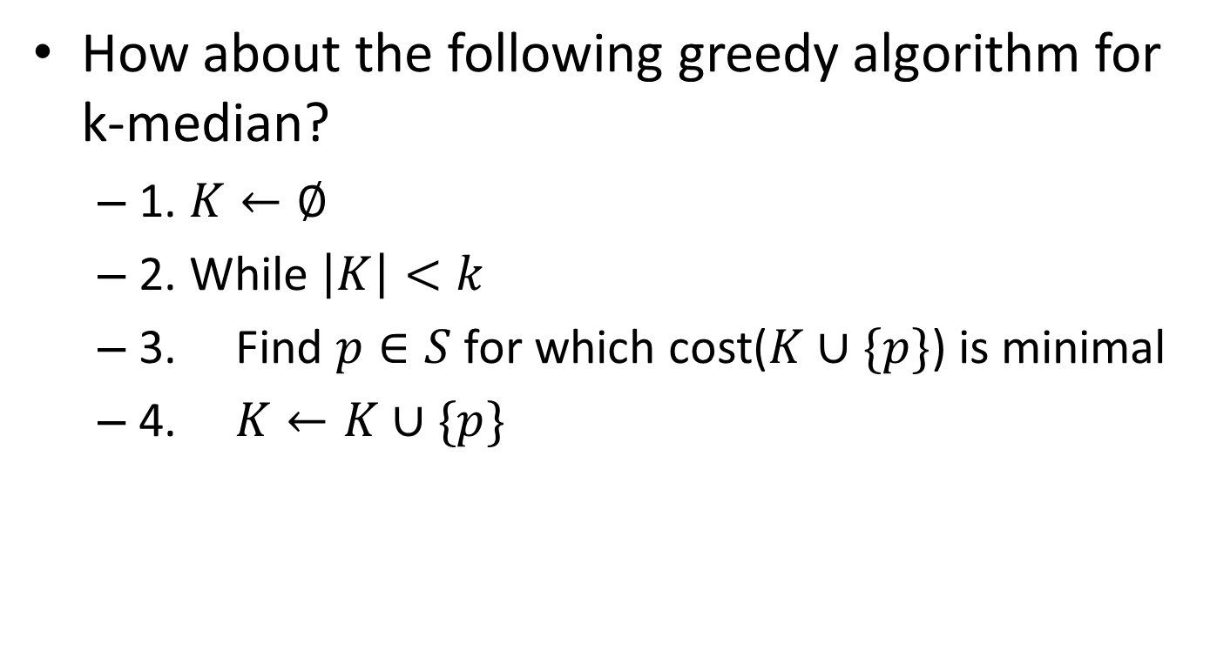
K-median
How about the following greedy algorithm for k-median?
1. $K←∅$
2. While $\left|K\right|<k$
3. Find $p∈S$ for which cost($K∪\{p\}$) is minimal
4. $K←K∪\{p\}$

Slide 29
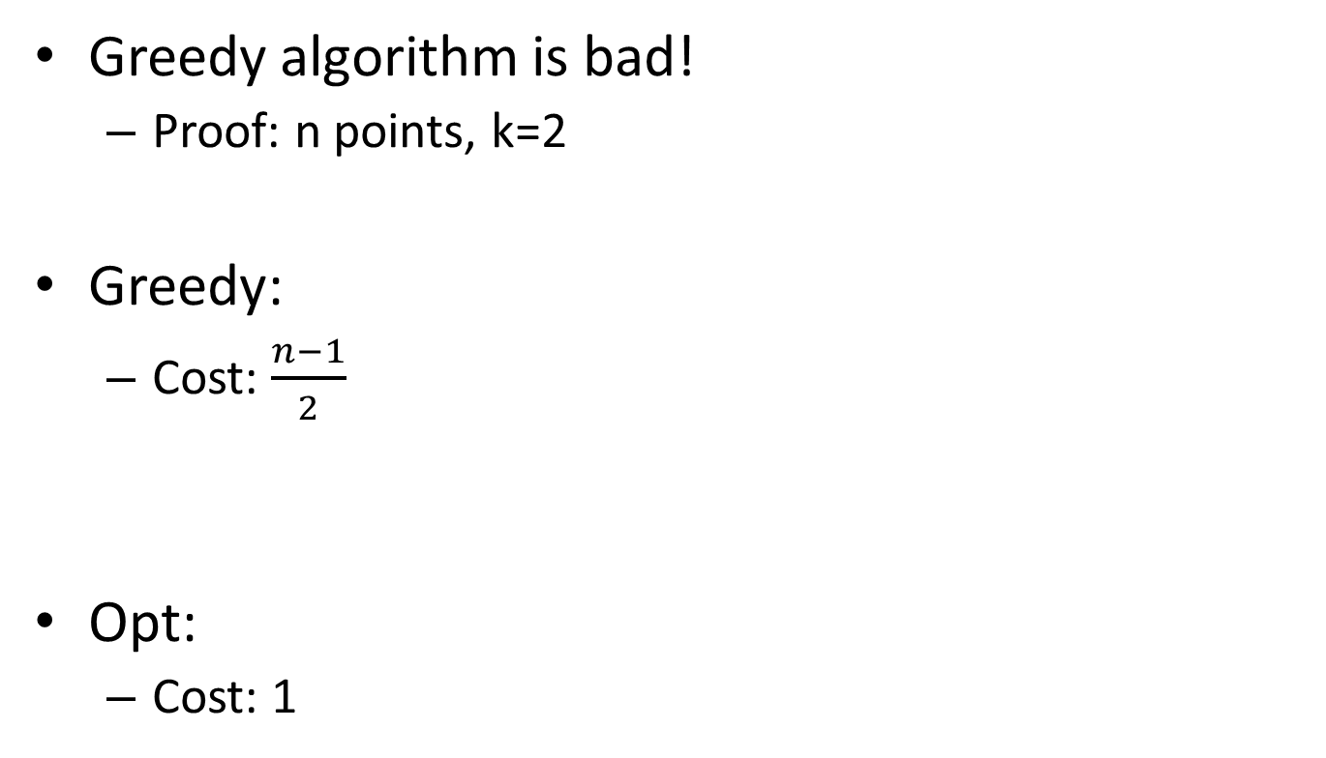
K-median
(n-1)/2
points
Greedy algorithm is bad!
Proof: n points, k=2
Greedy:
Cost: $\frac{n−1}{2}$
Opt:
Cost: 1
0
1
2

Slide 30
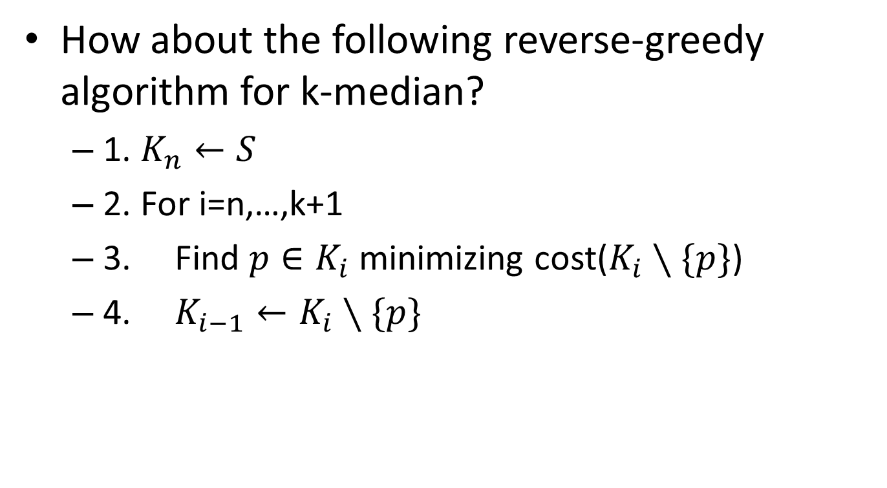
K-median
How about the following reverse-greedy algorithm for k-median?
1. $K_{n}←S$
2. For i=n,…,k+1
3. Find $p∈K_{i}$ minimizing cost($K_{i}∖\{p\}$)
4. $K_{i−1}←K_{i}∖\{p\}$

Slide 31
K-median
The reverse-greedy algorithm was suggested by Amos Fiat.
Chroback, Kenyon, Young:
reverse-greedy gives a logn-approximation.

Slide 32
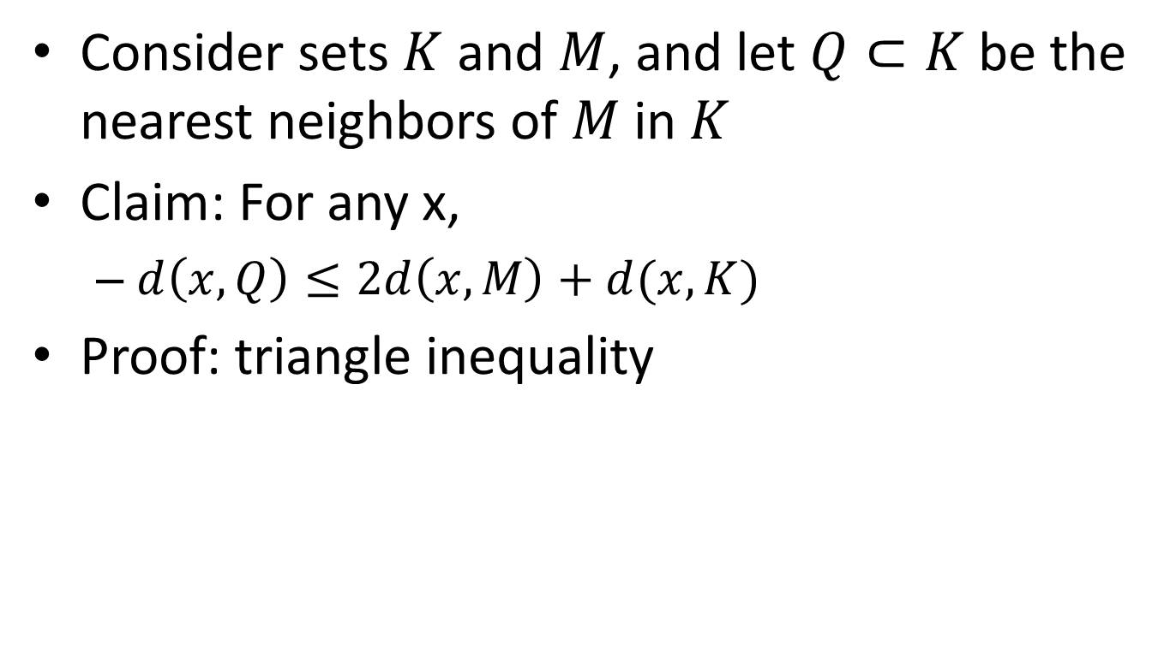
Preliminary
Consider sets $K$ and $M$, and let $Q⊂K$ be the nearest neighbors of $M$in $K$
Claim: For any x,
$d\left(x,Q\right)≤2d\left(x,M\right)+d(x,K)$
Proof: triangle inequality
≤ d(x,M) + d(x,K)
d(x,M)
K,Q
x
M

Slide 33
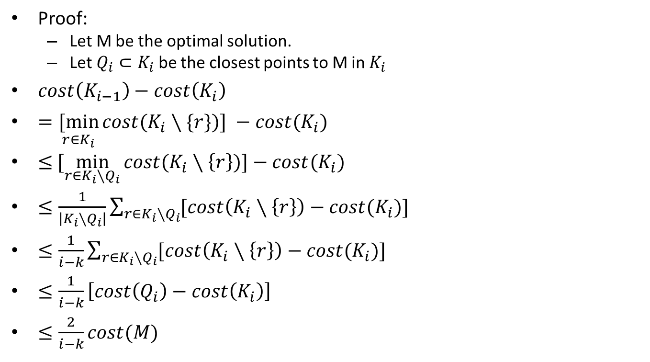
K-median
Proof:
Let M be the optimal solution.
Let $Q_{i}⊂K_{i}$ be the closest points to M in $K_{i}$
$cost\left(K_{i−1}\right)−cost\left(K_{i}\right)$
$=\underset{r∈K_{i}}{[min}{cost(K_{i}∖\{r\})] −cost(K_{i})}$
$≤$ $[\min_{r∈K_{i}∖Q_{i}}{cost(K_{i}∖\left\{r\right\})]−cost(K_{i})}$
$≤\frac{1}{\left|K_{i}∖Q_{i}\right|}\sum_{r∈K_{i}∖Q_{i}}{[cost\left(K_{i}∖\left\{r\right\}\right)−cost(K_{i}})]$
$≤\frac{1}{i−k}\sum_{r∈K_{i}∖Q_{i}}{[cost\left(K_{i}∖\left\{r\right\}\right)−cost(K_{i}})]$
$≤\frac{1}{i−k}\left[cost\left(Q_{i}\right)−cost\left(K_{i}\right)\right]$
$≤\frac{2}{i−k}cost(M)$
definition
smaller set
Min ≤ Average
|Q_{i}|≤ k
Removed at once
Previous slide

Slide 34

K-median
Sum of cost increases is a Harmonic series
$$\frac{1}{n}+\frac{1}{n−1}+…=O(\log{n})$$
So we have logn-approximation

Slide 35
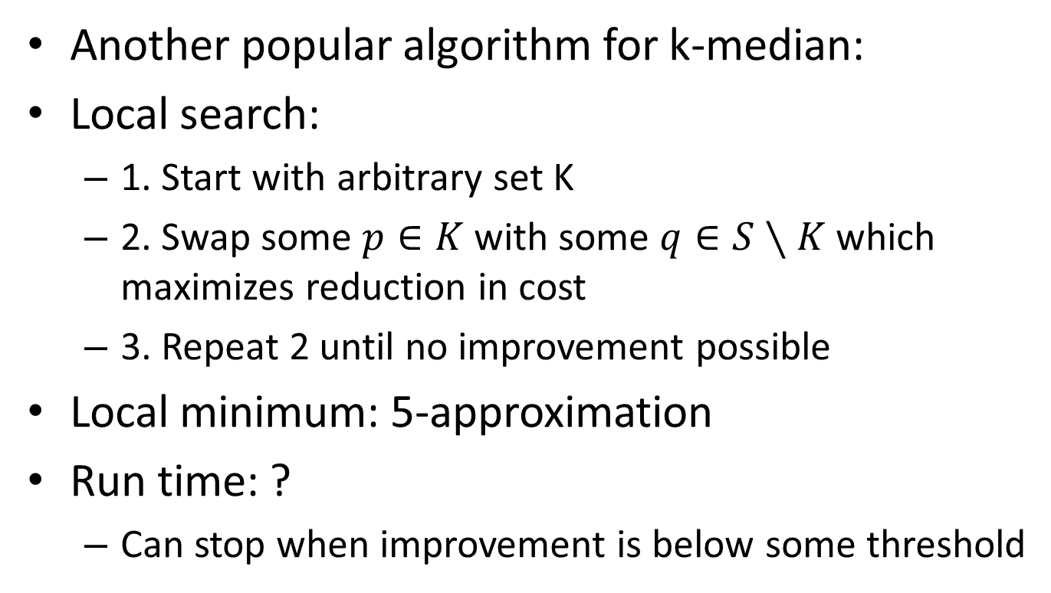
K-median
Another popular algorithm for k-median:
Local search:
1. Start with arbitrary set K
2. Swap some $p∈K$ with some $q∈S∖K$ which maximizes reduction in cost
3. Repeat 2 until no improvement possible
Local minimum: 5-approximation
Run time: ?
Can stop when improvement is below some threshold

Slide 36
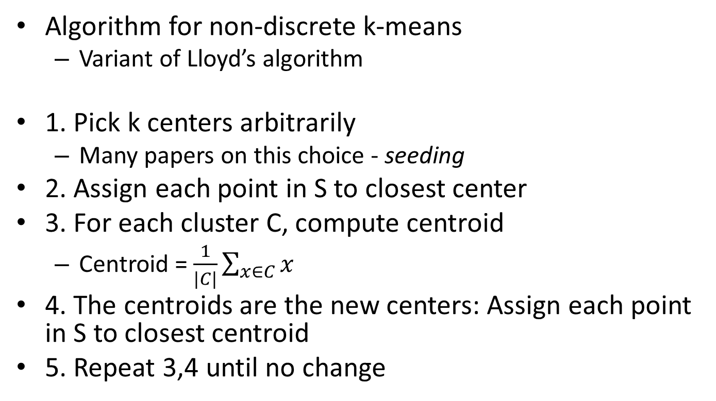
k-means algorithm
Algorithm for non-discrete k-means
Variant of Lloyd’s algorithm
1. Pick k centers arbitrarily
Many papers on this choice - seeding
2. Assign each point in S to closest center
3. For each cluster C, compute centroid
Centroid = $\frac{1}{|C|}\sum_{x∈C}{x}$
4. The centroids are the new centers: Assign each point in S to closest centroid
5. Repeat 3,4 until no change

Slide 37
k-means algorithm
Example
S
Choose 2 centers
Compute centroids
Reassign points

Slide 38
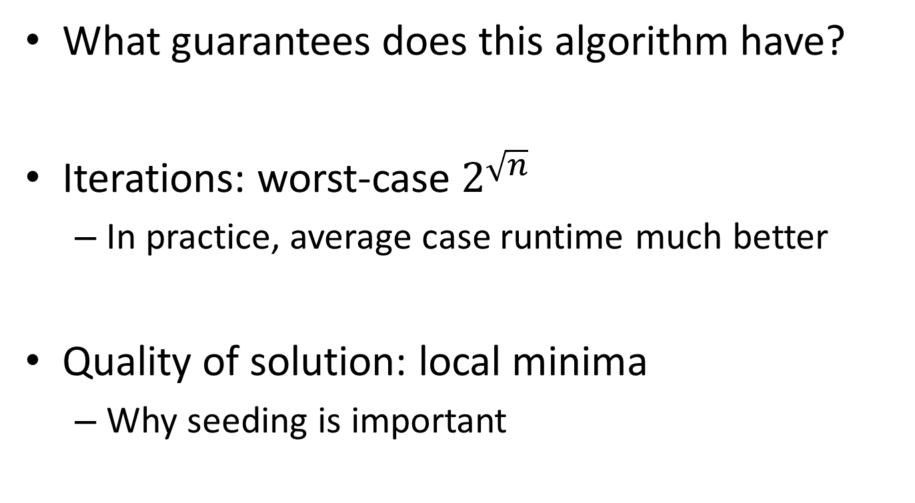
k-means
What guarantees does this algorithm have?
Iterations: worst-case $2^{\sqrt{n}}$
In practice, average case runtime much better
Quality of solution: local minima
Why seeding is important

